Slide 1
RNNs
NLP Course
June 2019

Slide 2
Basic NN with single hidden layer
Output: batch_size * #classes
Matrix product; softmax
Hidden: batch_size * # activations
Matrix product; relu
Output
Input: batch_size * #inputs
Hidden
Input

Slide 3
Predicting word 3 using words 1 & 2
NB: layer operations not shown; remember that arrows represent layer operations
word 3 output: vocab size
Single fully connected model
FC2: # activations
word 2 input
FC1: # activations
Output
Hidden
Input
word 1 input: vocab size

Slide 4
Predicting word 4 using words 1, 2 & 3
Input→Hidden
word 4 output: vocab size
Hidden→Output
Hidden→Hidden
FC3: # activations
word 3 input
FC2: # activations
word 2 input
FC1: # activations
word 1 input: vocab size

Slide 5
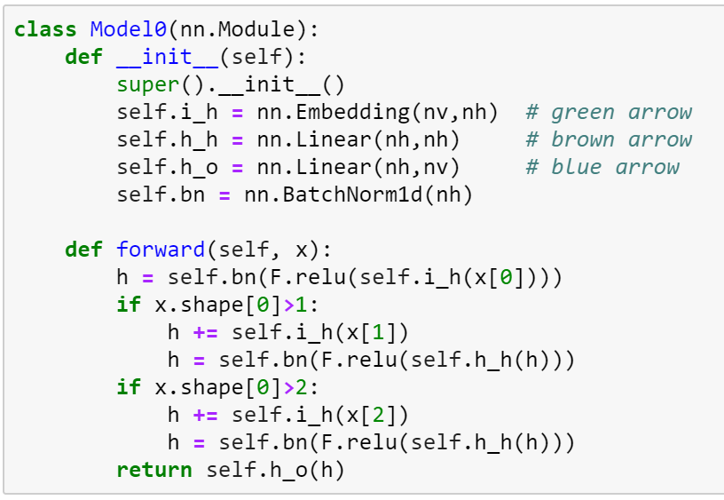
Predicting word 4 using words 1, 2 & 3
Target: “,”
word 3 input
“two”
word 2 input
“,”
“one”

Slide 6
Predicting word n using words 1 to n-1
NB: no hidden/output labels shown
Same thing with a loop
Input→Hidden
Hidden→Output
Hidden→Hidden
word n input
Repeat for 2→n-1
Output
Hidden
Input
word 1 input

Slide 7
Predicting words 2 to n using words 1 to n-1
Multi fully connected model
Input→Hidden
Hidden→Output
Hidden→Hidden
word n input
Repeat for 1→n-1
Output
Hidden
Initialize to zeros
Input

Slide 8
Predicting words 2 to n using words 1 to n-1 using stacked RNNs
Repeat for 1→n-1
word n input
Repeat for 1→n-1
Initialize to zeros
Initialize to zeros

Slide 9
Unrolled stacked RNNs for sequences
word 3 input
word 2 input
word 1 input

Slide 10
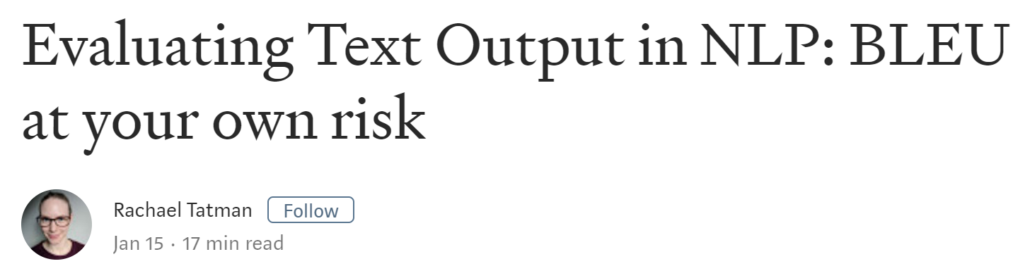
Strengths of BLEU
It’s fast and easy to calculate, especially compared to having human translators rate model output.
It’s ubiquitous. This makes it easy to compare your model to benchmarks on the same task.

Slide 11
Weaknesses of BLEU
It doesn’t consider meaning
Correct: I ate the apple.
These wrong sentences all have same BLEU score:
I ate an apple.
I consumed the apple.
I ate the potato.
It doesn’t directly consider sentence structure
It doesn’t handle morphologically rich languages well
It doesn’t map well to human judgements

Slide 12
For systems going into production, do at least one round of system evaluation with human experts.
Before you get to that round, you’ll probably need to use at least one automatic evaluation metric. Use BLEU if and only if:
You’re doing machine translation AND
You’re evaluating across an entire corpus AND
You know the limitations of the metric and you’re prepared to accept them.

Slide 13
GRUs

Slide 14
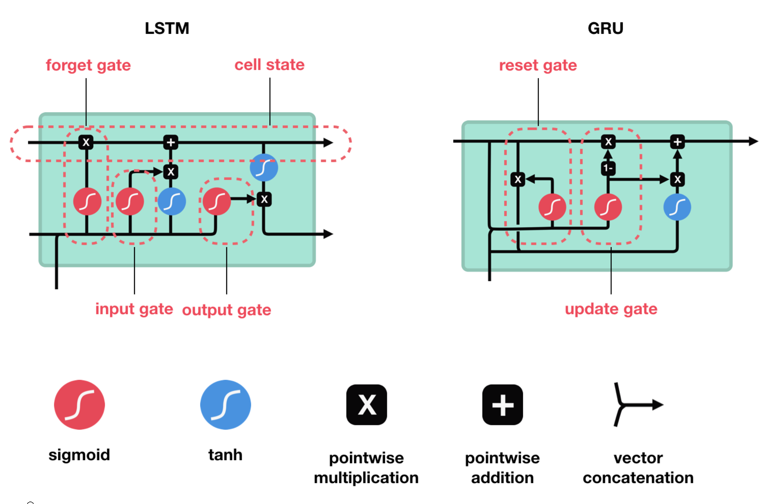
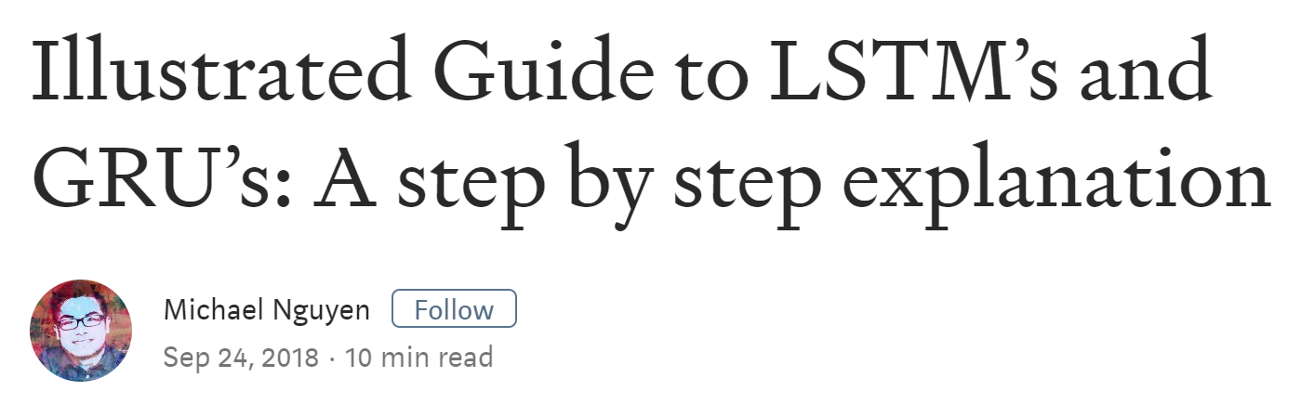
The problem: RNNs suffer from short-term memory
As your input sequence gets longer, RNNs have more trouble remembering what happened early on.
LSTMs & GRUs address this.
“I grew up in France, and moved to the USA when I was 25. I still speak fluent _____.”

Slide 15
A simple RNN

Slide 16
Sigmoid is between 0-1:
0 indicates forgetting

Slide 17

GRU in equations
hidden state: h_{t}
input: x_{t}
update gate: z_{t} = sig(A x_{t} + B h_{t-1})
reset gate: r_{t} = sig(C x_{t} + D h_{t-1})
new gate: n_{t} = tanh(G x_{t} + H r_{t} $⊗$h_{t-1})
hidden state: h_{t} = z_{t} $⊗$n_{t} + (1 – z_{t}) $⊗$ h_{t-1}

